Slide 1






Findings and Learning from Australia - Indonesia Infrastructure Research Awards (AIIRA)

Slide 2

The Role of Regulatory Frameworks in Ensuring The Sustainability of Community-Based Water And Sanitation

Slide 3


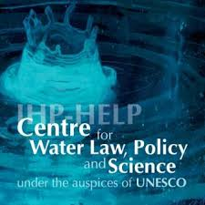



Reviewers:
Prof Geoffrey D Gooch
Dr. Sarah Hendry
Researchers:
Dr. Mohamad Mova AlÁfghani (Principal Investigator)
Dyah Paramita
Jibriel Avessina
Feril Hariati
Aftaf Muhajir
Bappenas Contact:
Eko Wiji Purwanto
Jejaring AMPL:
Dormaringan Saragih
Center for Regulation, Policy and Governance (CRPG) Universitas Ibn Khaldun Bogor
UNESCO Centre for Water Law, Policy and Science, University of Dundee, UK
National Planning Agency (Bappenas)
Jejaring AMPL

Slide 4
Problematique

Slide 5

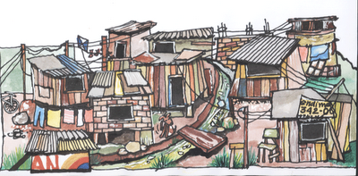

2019 Target: 100-0-100
= 100
= 0
= 100
Community Based Water Supply are expected to contribute 60% (FGD Result). The expected contribution from community sanitation could be higher.

Slide 6
However…., there are some problems
The delineation between “community” and “institution” in government policy papers are not clear
There is no clear definition on what is meant by “community”
Policy makers are not clear whether community based system is a “temporary” or long-term solution
National regulatory framework is “discriminatory” towards community based watsan
Community watsan’s assets are not legally secured
There are overlaps and potential conflict between community watsan service and PDAMs
Most community watsan’s initiative have no legally secured access to water source
Aside from the above, regions have started to enact and enforce regional by-laws Drinking Water and Environmental Health (Peraturan Daerah AMPL) – often with substandard legal drafting quality.

Slide 7
Research Question
How can Regulatory Frameworks Ensure the Sustainability of Community Based Water and Sanitation?

Slide 8
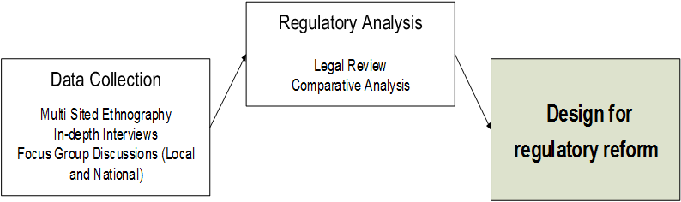
Methodology 1

Slide 9
Methodology 2
Focus Group Discussions:
National FGDs
Scoping and Problem-Verification: Hotel Alila, Jakarta, October 11, 2013
Project Recommendation and Comments: Hotel Akmani, Jakarta, March 26, 2015
Local FGDs
Ende, October 11, 2013
Lamongan, January 26, 2015
Interviews:
National Level (Bappenas/Pokja/NGOs), Provincial Level (Bappeda Prov),
Regency Level (Bappeda Kabupaten), Village Level, CBO Level
Report Writing Workshop:
Bogor, Hotel Novotel, February 8th, 2015 (Chaired by Geoffrey Gooch, PhD)

Slide 10
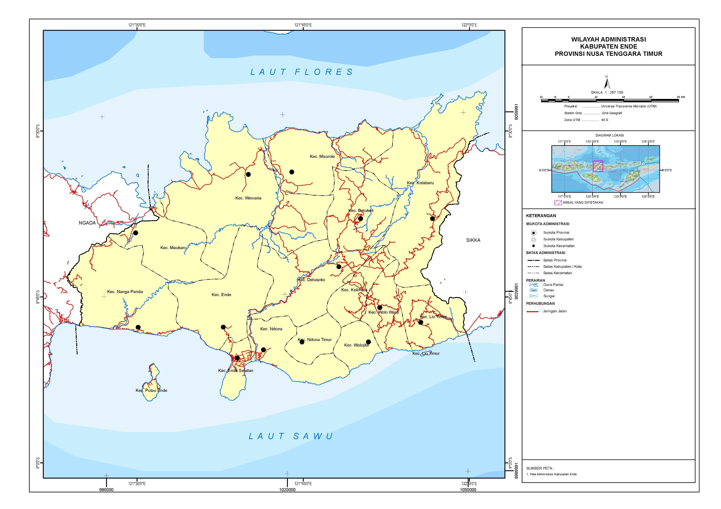
Methodology 3: Case Study

Slide 11
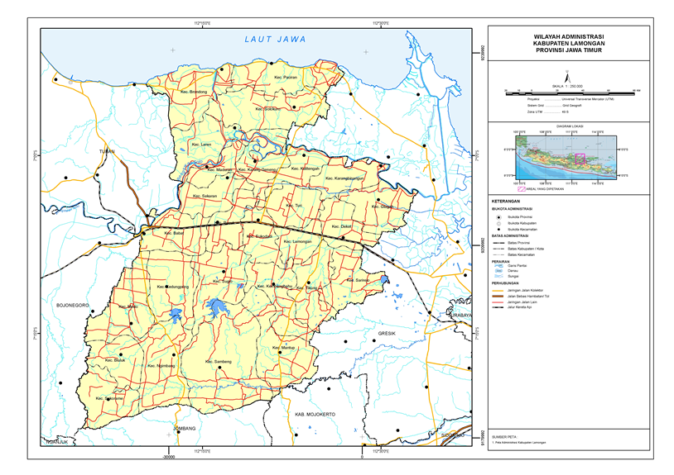
Methodology 4: Case Study

Slide 12
Analytical Framework
& Findings

Slide 13
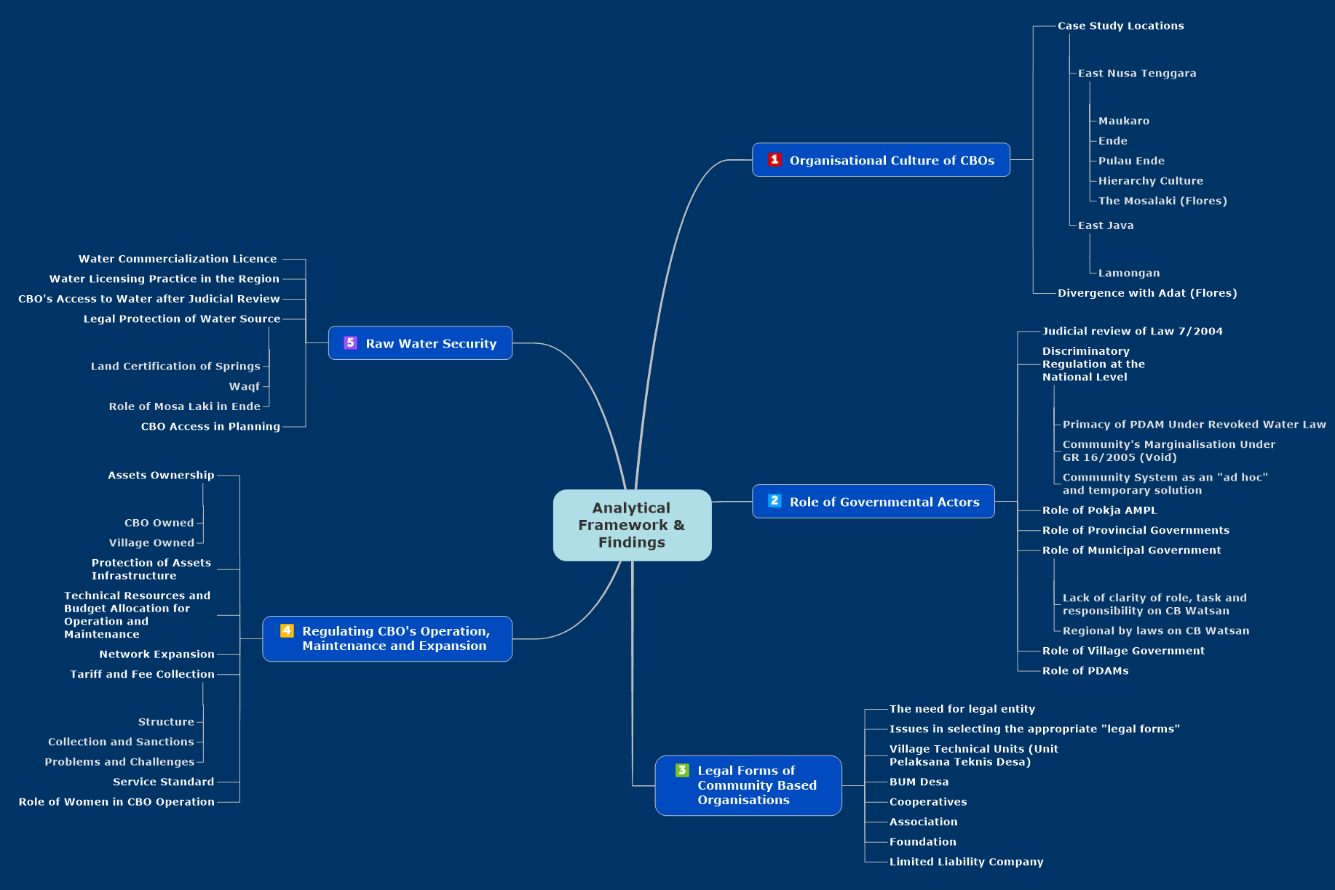

Slide 14
Recommendations
In regions where Adat is prevalent, CB-Watsan initiatives should be integrated with Adat, both in pre and post construction stages
Limited professionalization is the way forward
CB-Watsan should be recognized as a distinctive actor and model of provision
National Legislations must regulate CB-Watsan in alongside the “institutional” system, with equal detail (service levels, quality, redress, etc)
Regulatory framework must clarify the roles and responsibilities of local agencies in post construction stage
CB Watsan and non-CB Watsan Planning Framework must be integrated
Legal forms of CBO should be compatible with the “CB-Watsan” concept
Most CB Watsan (immovable property) assets are ownerless. Assets must be owned, either by CBO or by Village
Assets Infrastructure should be protected by a combination of Regional By Law, Village Regulation and (where applicable) Adat
There should be a specific type of CB-Watsan water abstraction licence
CBO should be granted access to all planning instruments

Slide 15
Field Study

Slide 16
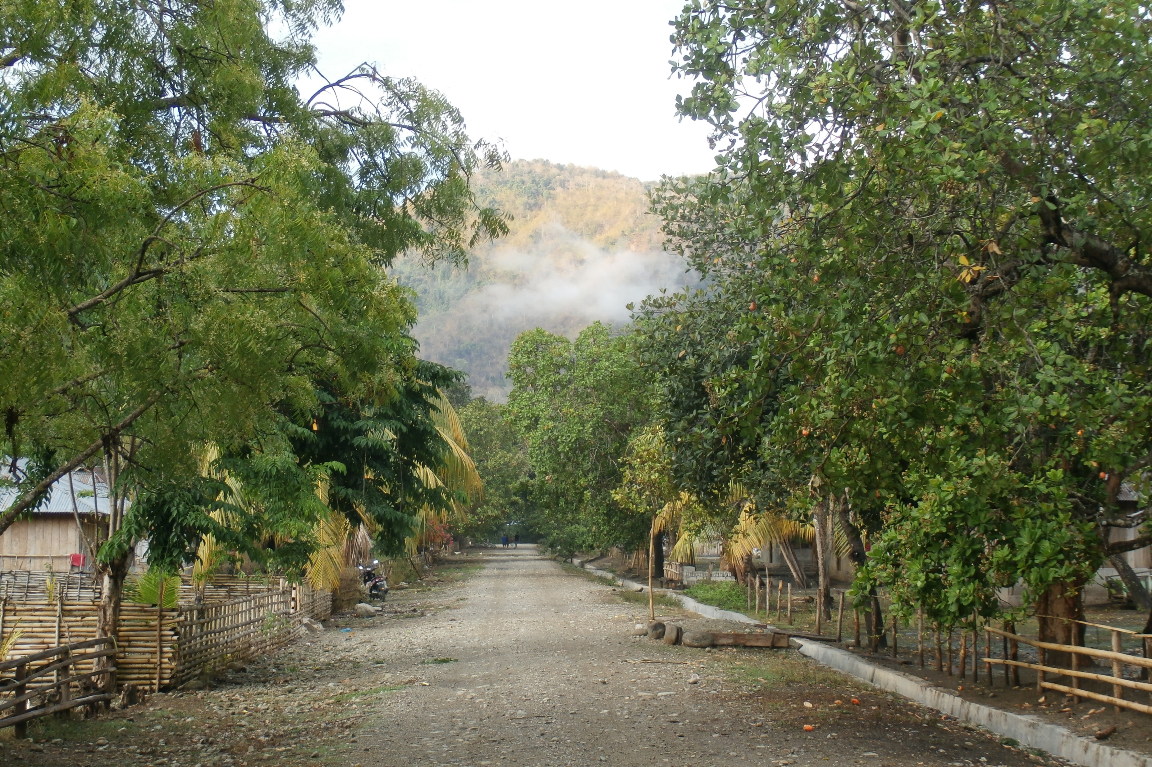
Village road in Maukaro

Slide 17
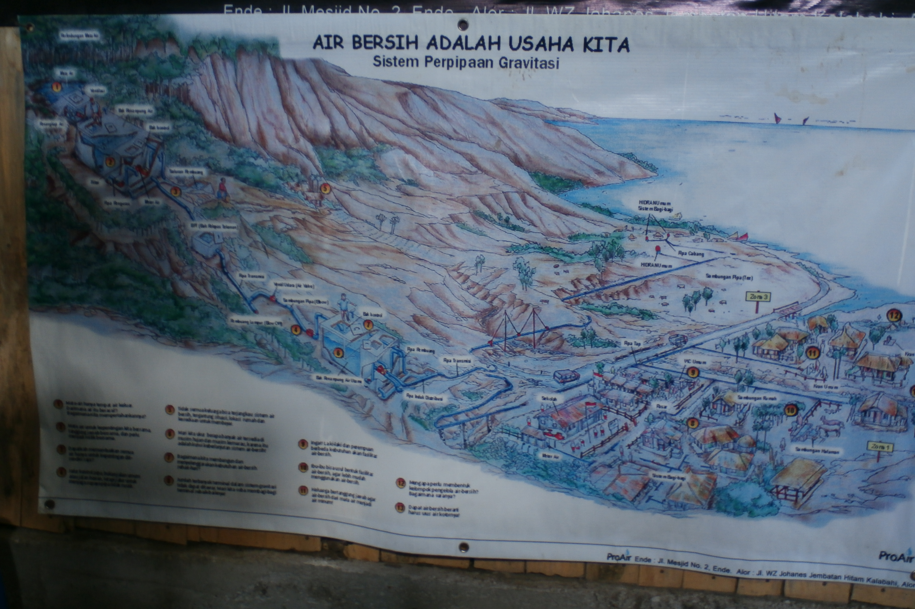
Gravity fed system in Maukaro, constructed by the Pro Air Project.
Gravity fed system was considered the most appropriate, as electricity is intermittent (lighting starts only from 18.00-06.00)
The system use steel pipes with 50 years timeline. However, only 1 system -----(Koja Aje) out of 4 – is still functioning. The other systems cease operation after 1-2 years after construction

Slide 18
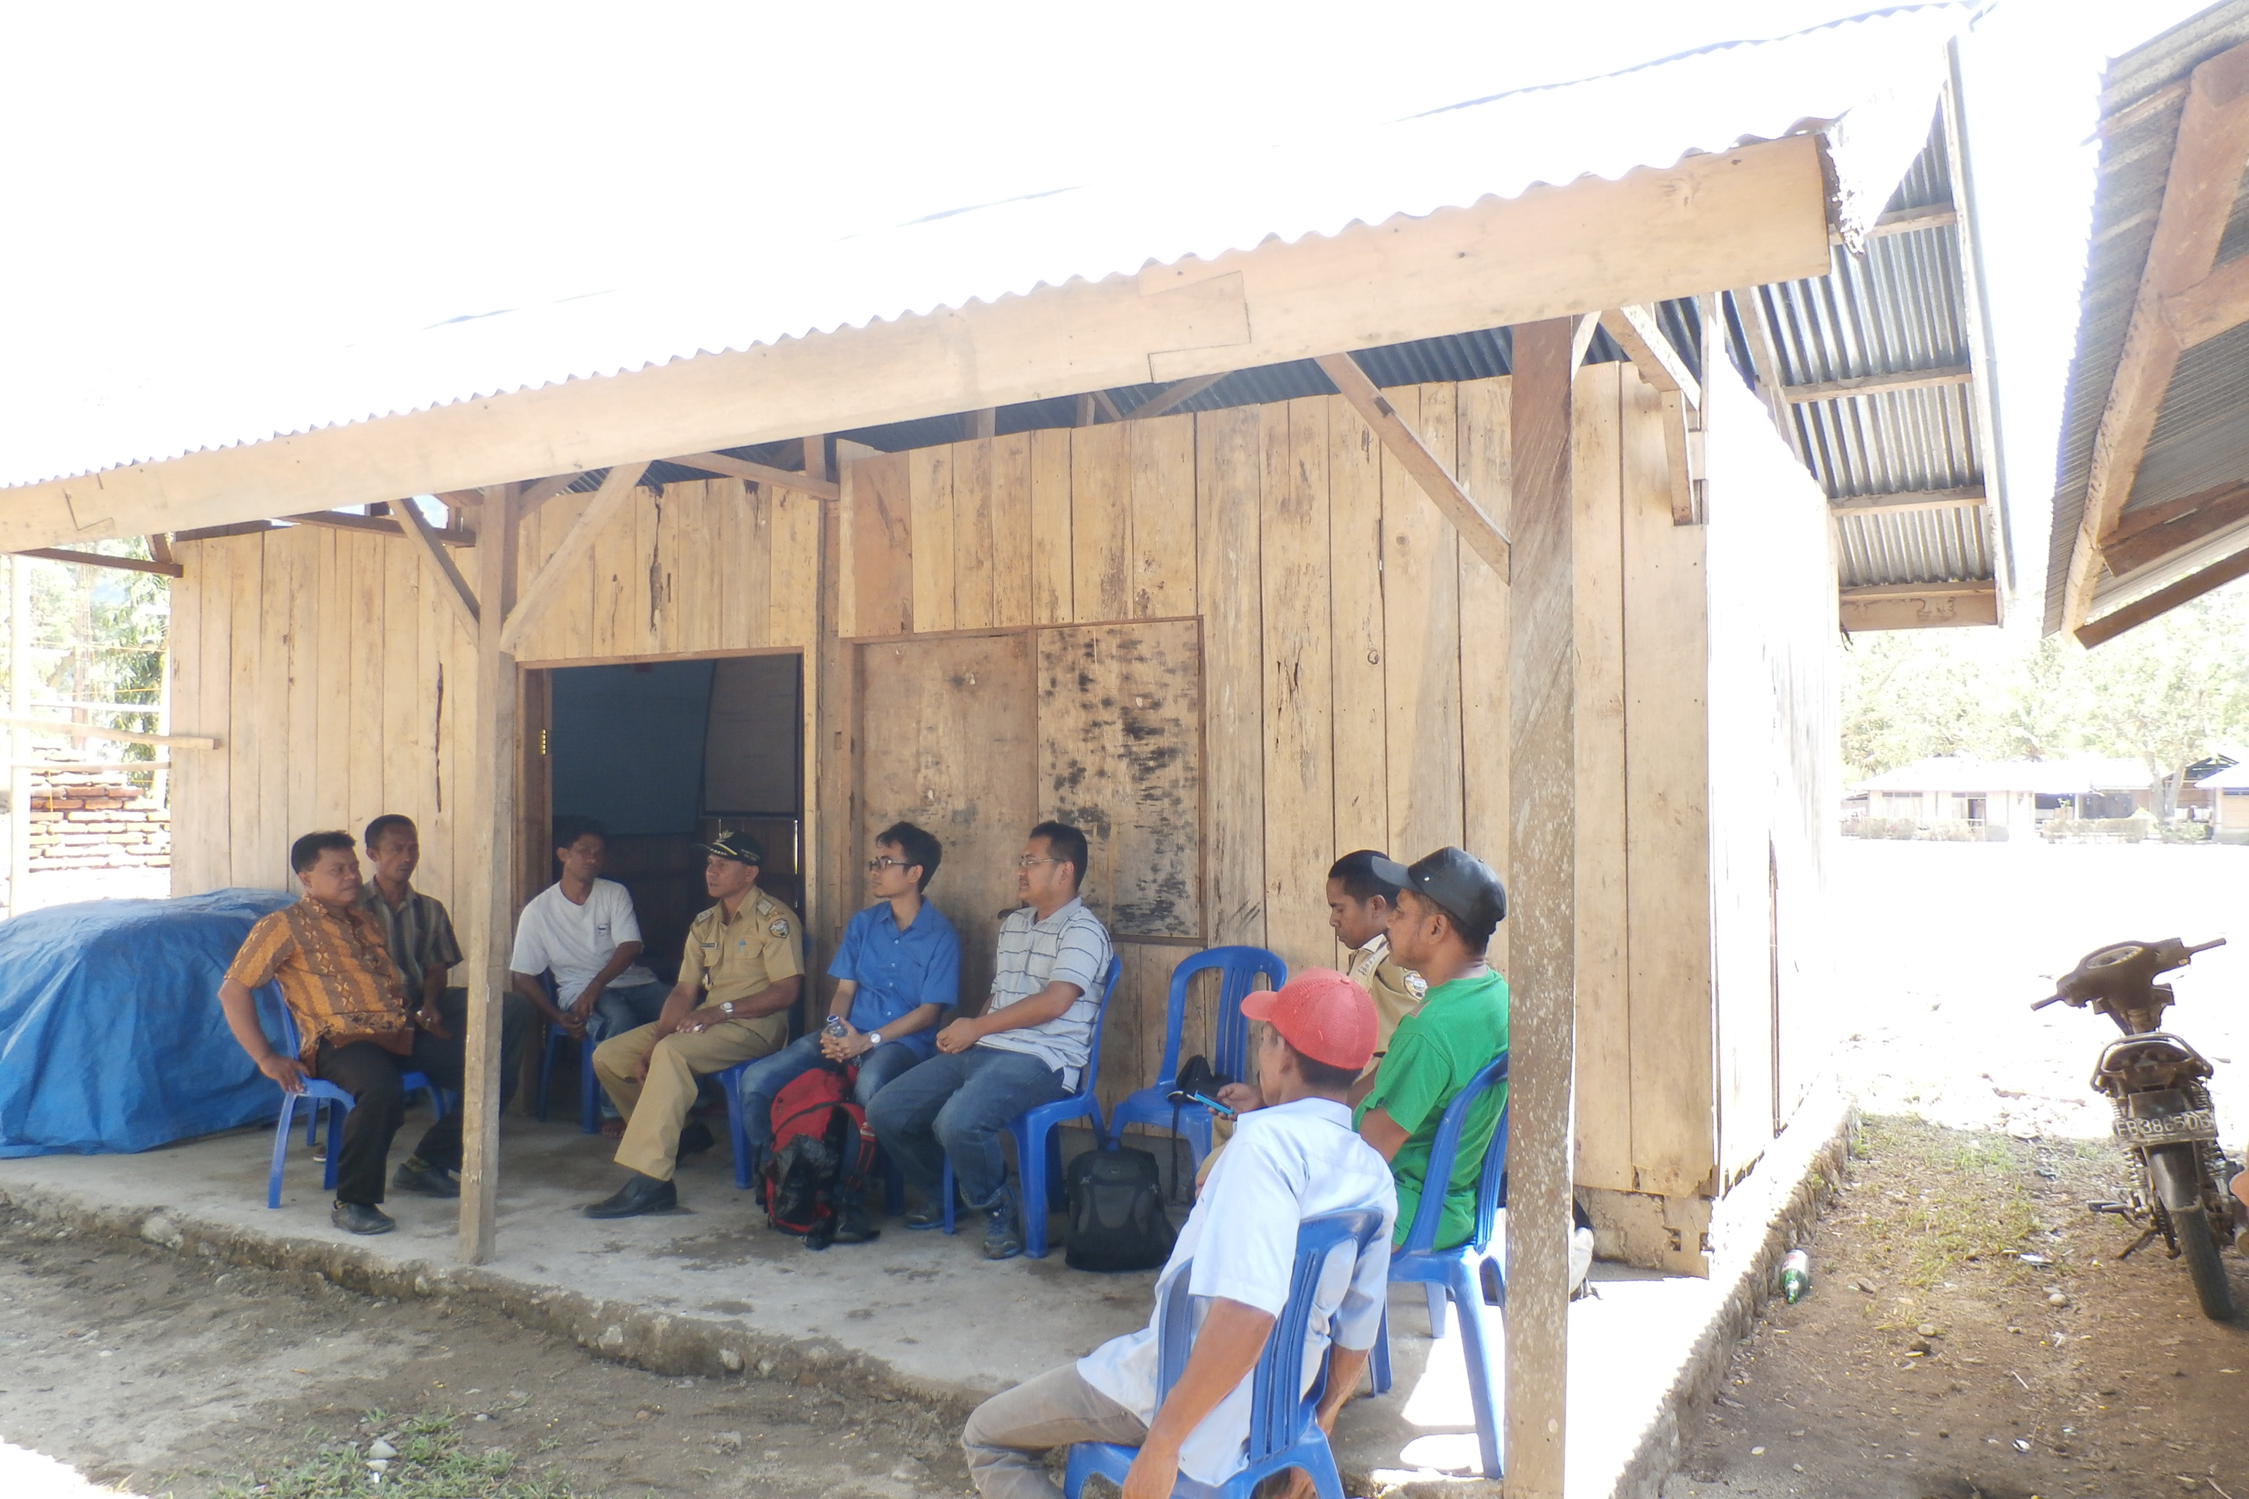
The Office of BPSAB Koja Aje. Agus Meo, the Chairman, sits on the far left

Slide 19
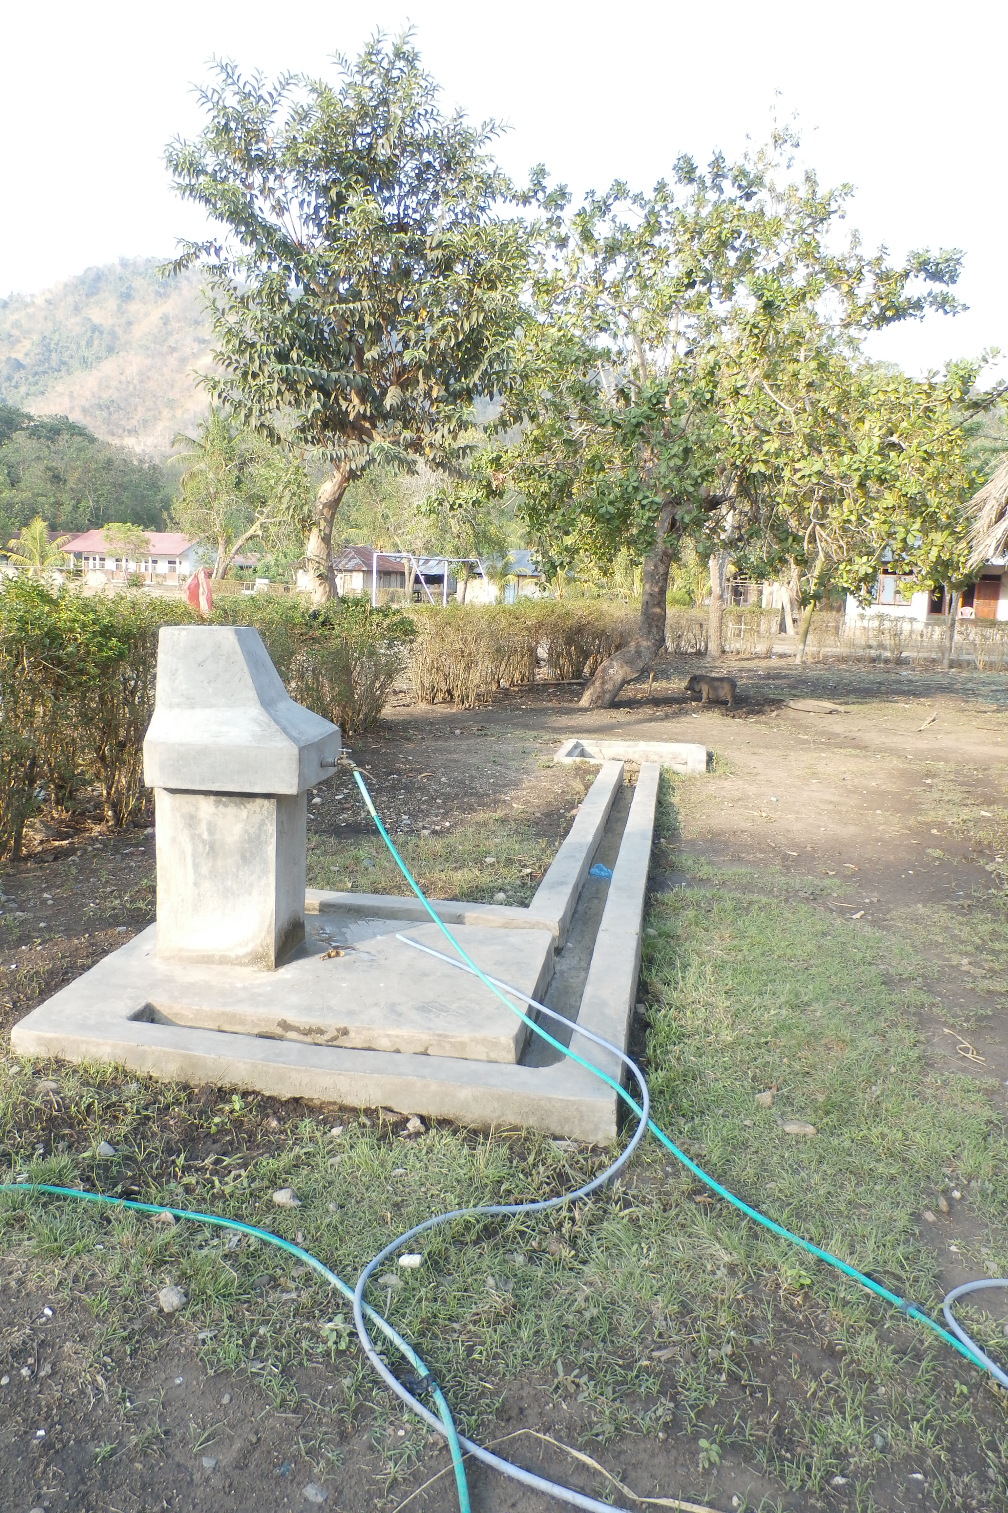
The public standpipe at BPSAB Koja Aje (Maukaro). The standpipe can serve 4-5 houses with stable pressure. Mosalaki (the Adat Chiefs) – as a compromise – are given their own standpipe.
New connection: connection costs could be prohibitive (due to the cost of piping). Limited pressure may not be able to withstand population growth.

Slide 20
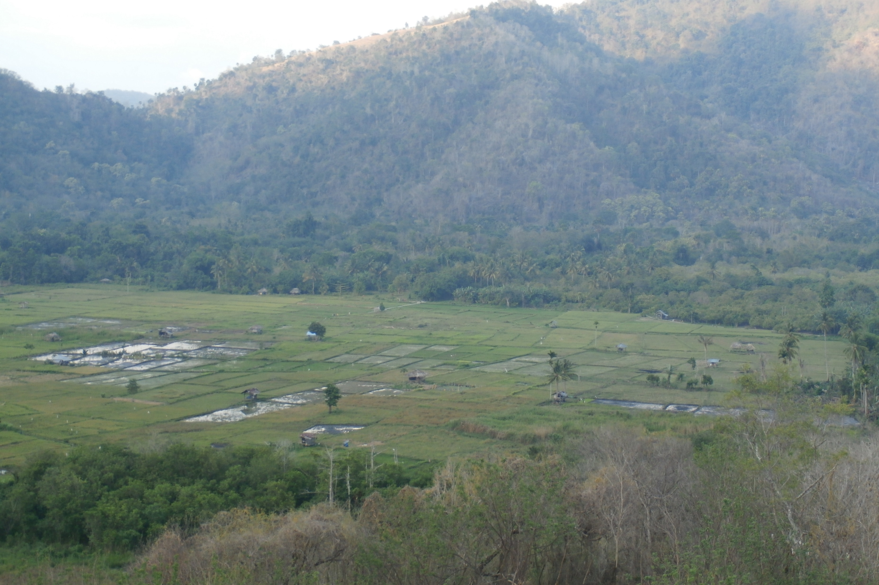
The forest is protected by Adat. Illegal tree cutting will be fined with 1 jar (equals to 40 bottles) of Mokke (traditional liquor), 1 sack of rice and 1 big swine

Slide 21
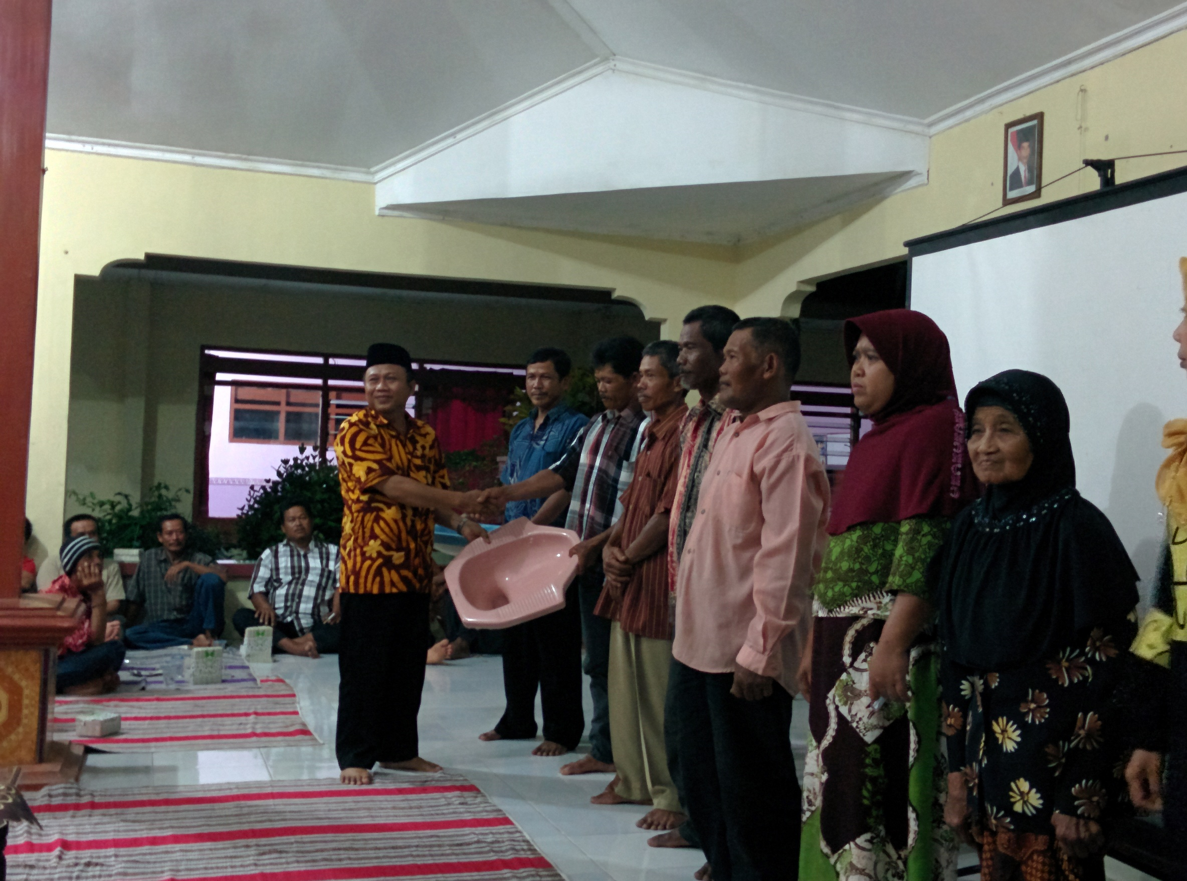
Panggeng Siswadi, Chairman of HIPPAMS Tirto Agung, Lamongan hand over closet to villagers

Slide 22
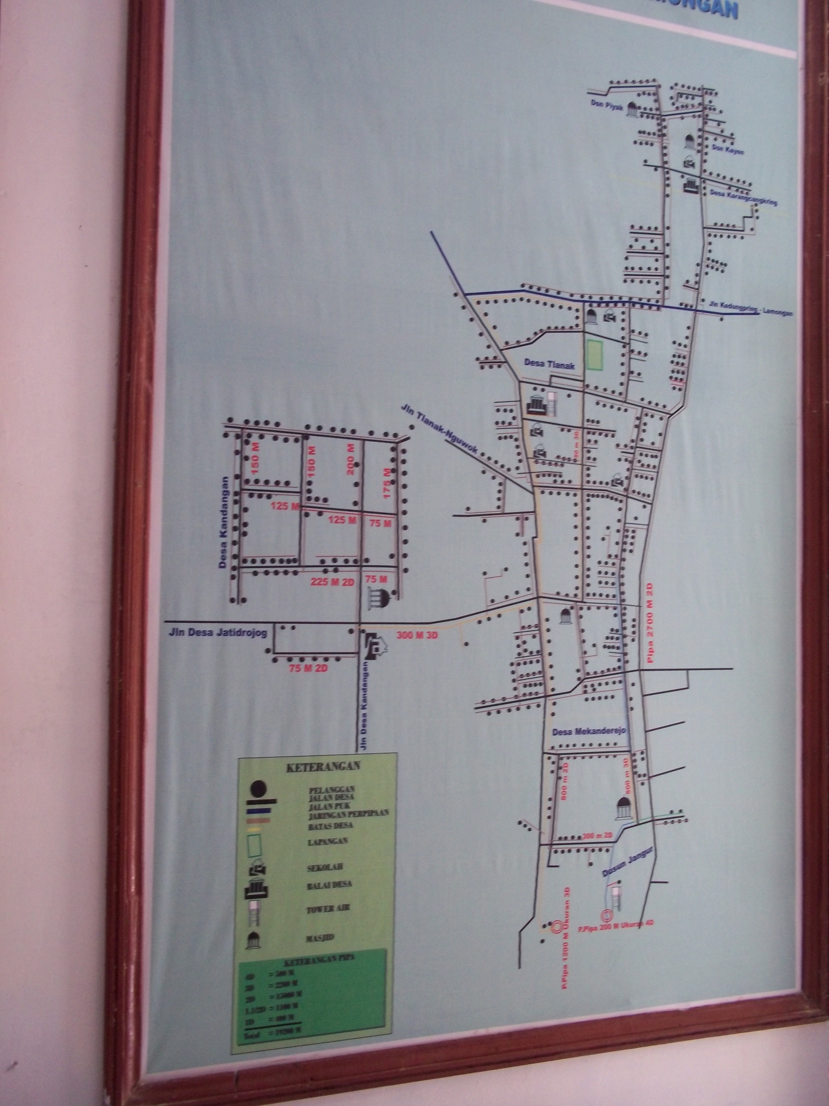
Network expansion has been successful in Tlanak, Lamongan. Initially only 125 household connection (thus, not standpipes as in Maukaro), now – through several consecutive programs-- there are 1200 HC.

Slide 23
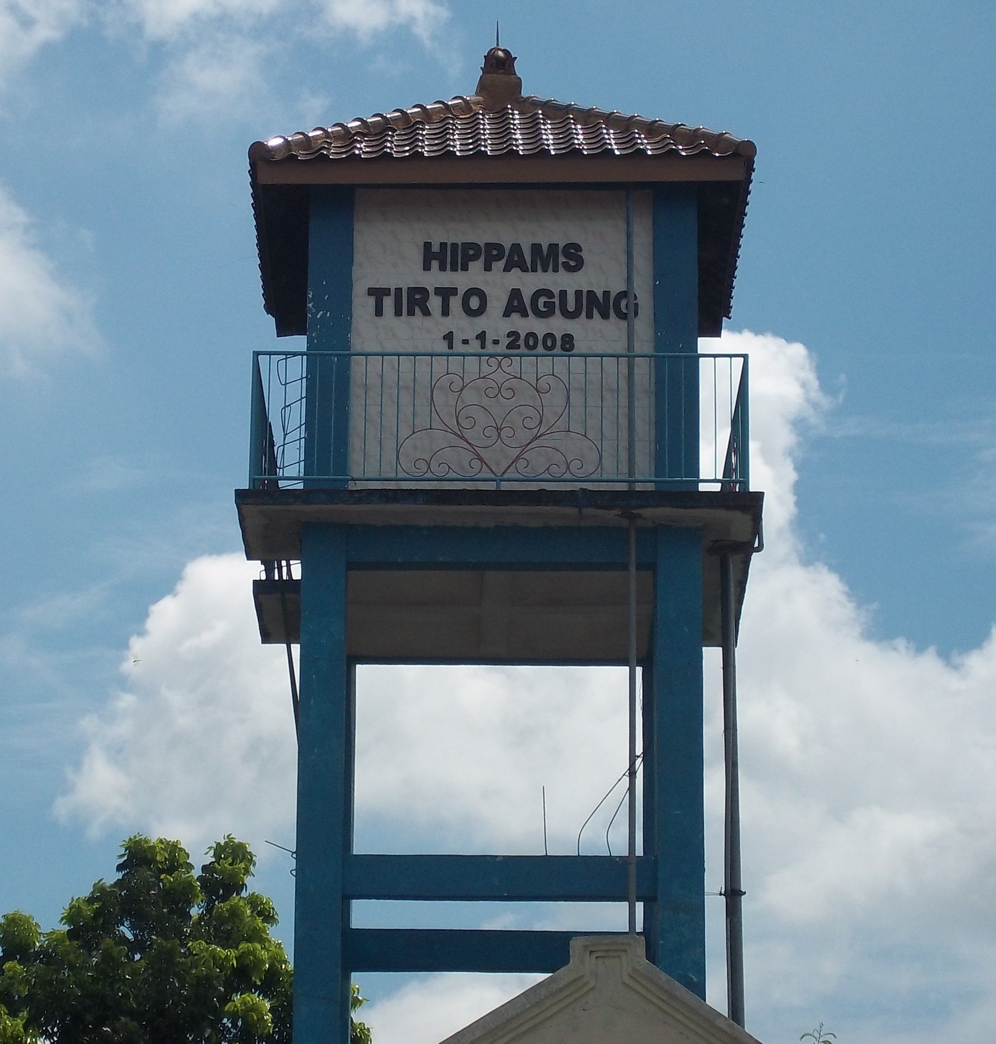
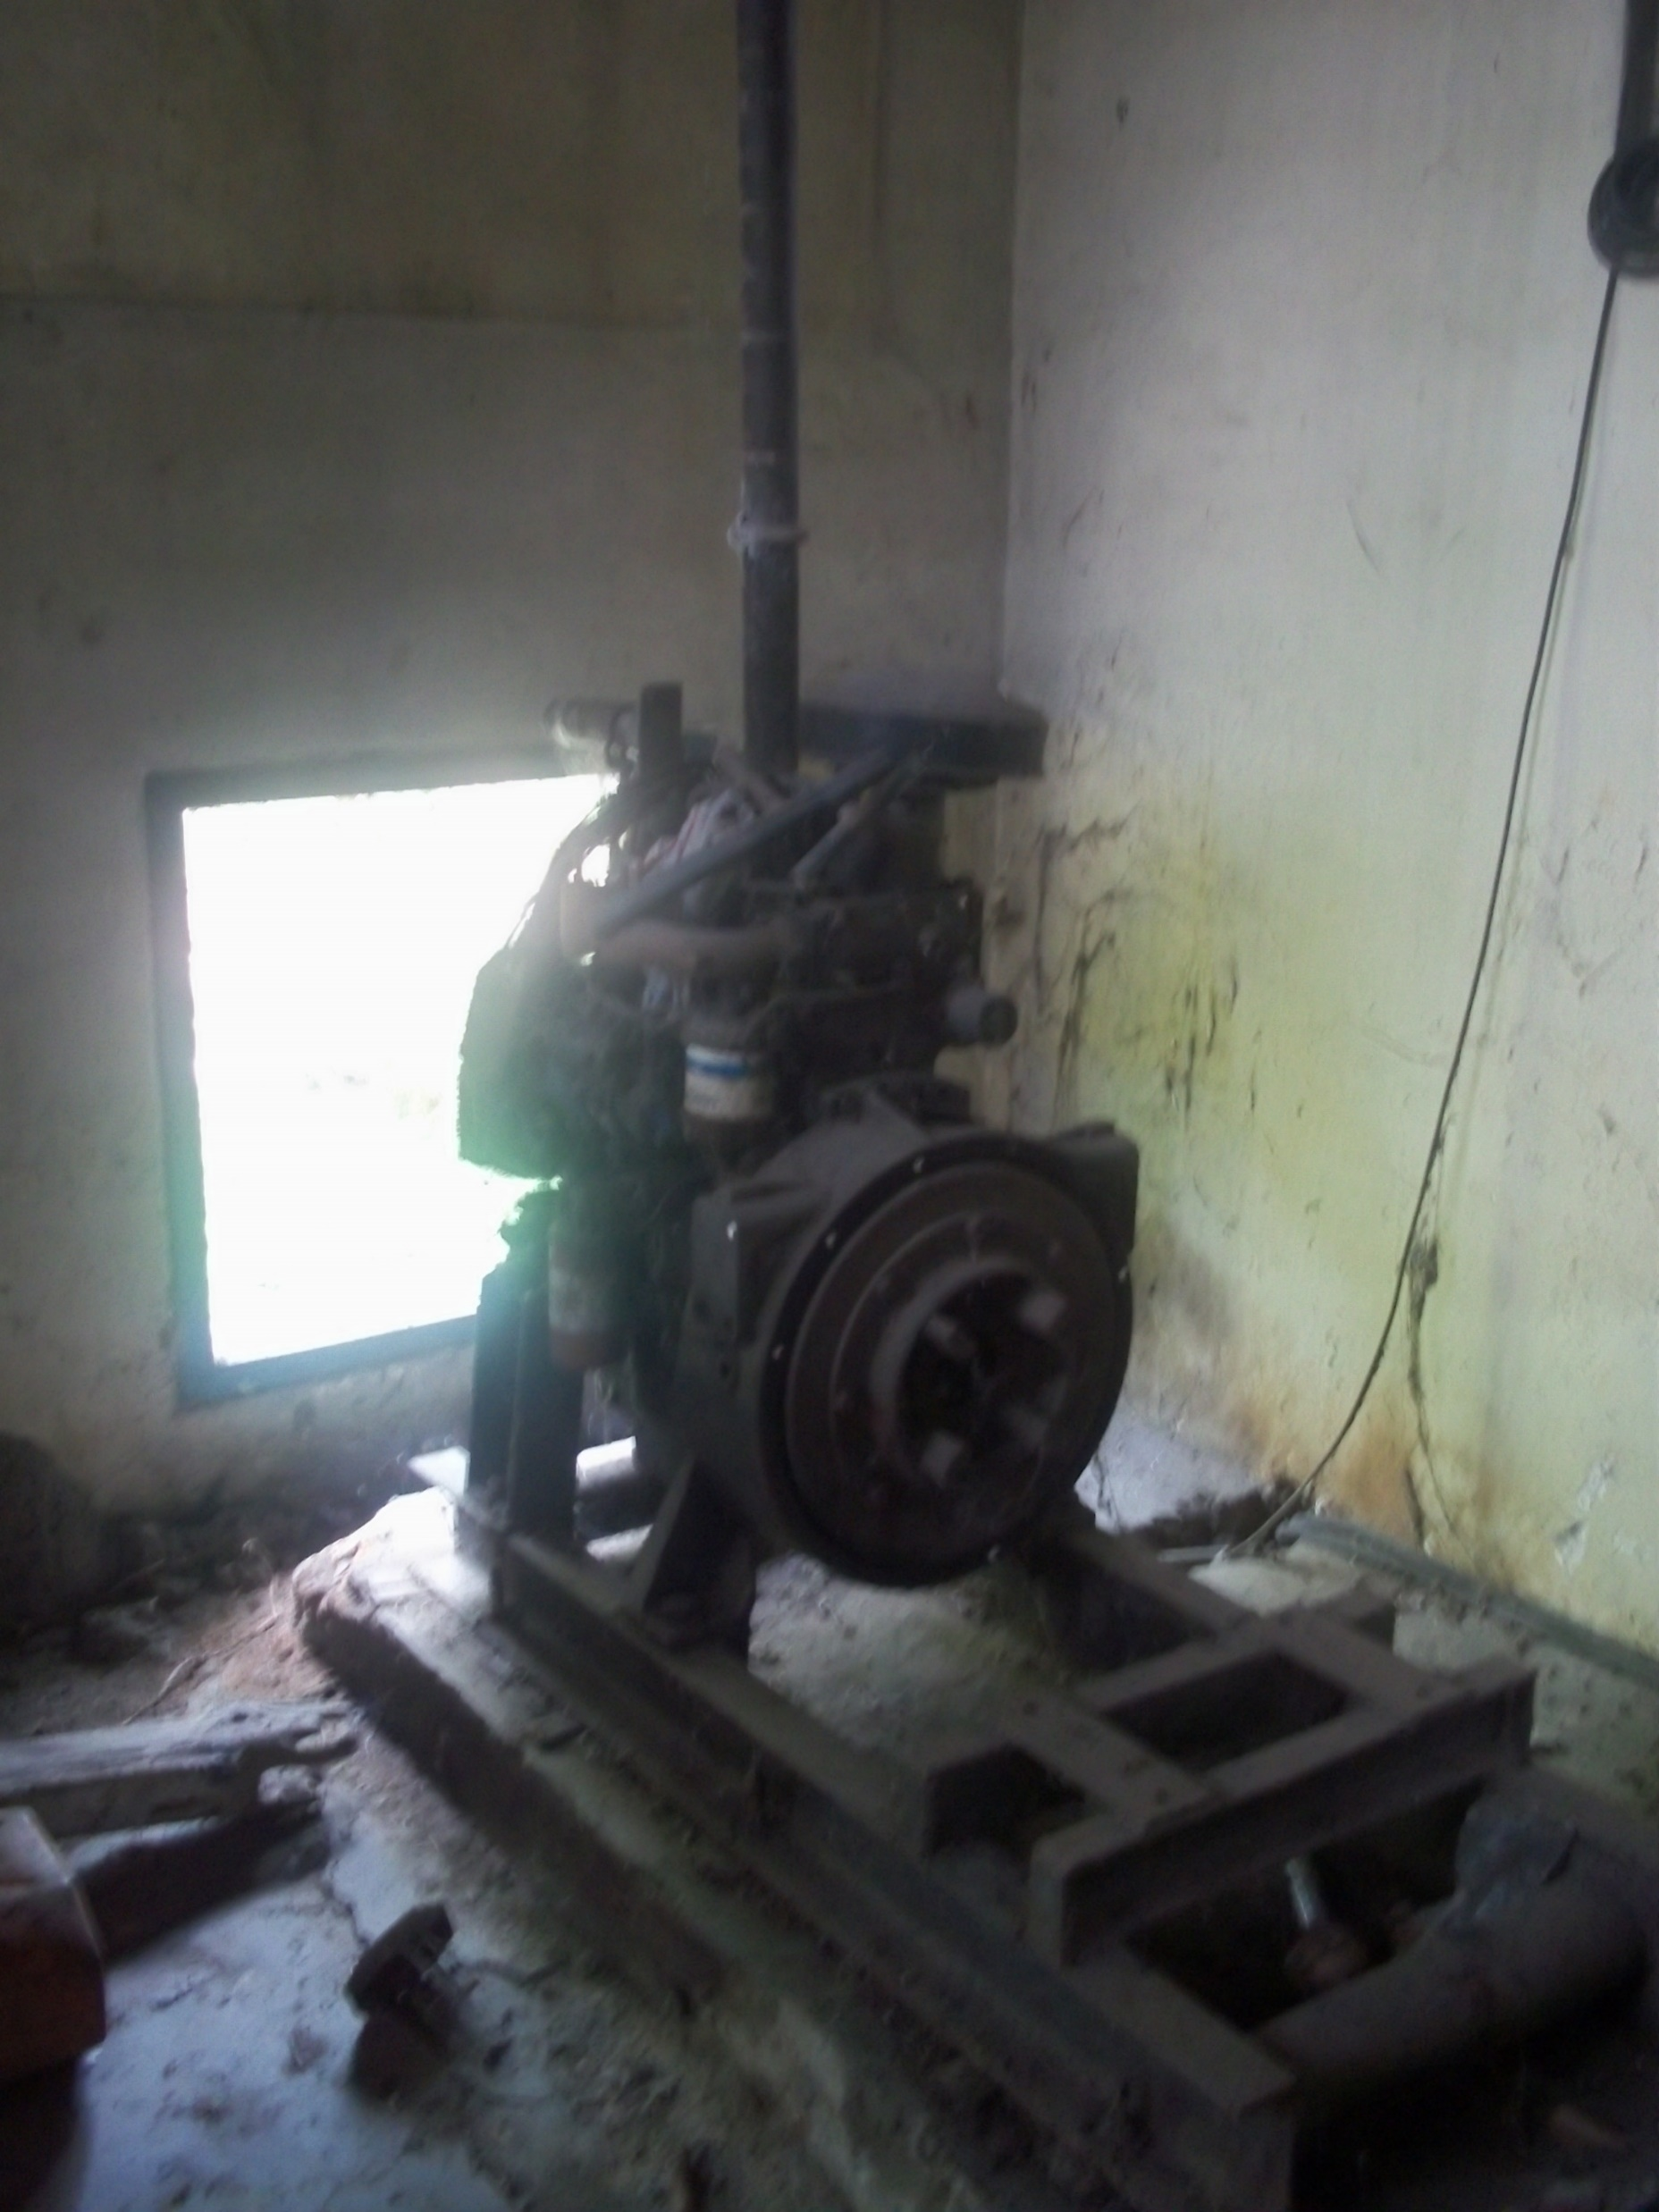
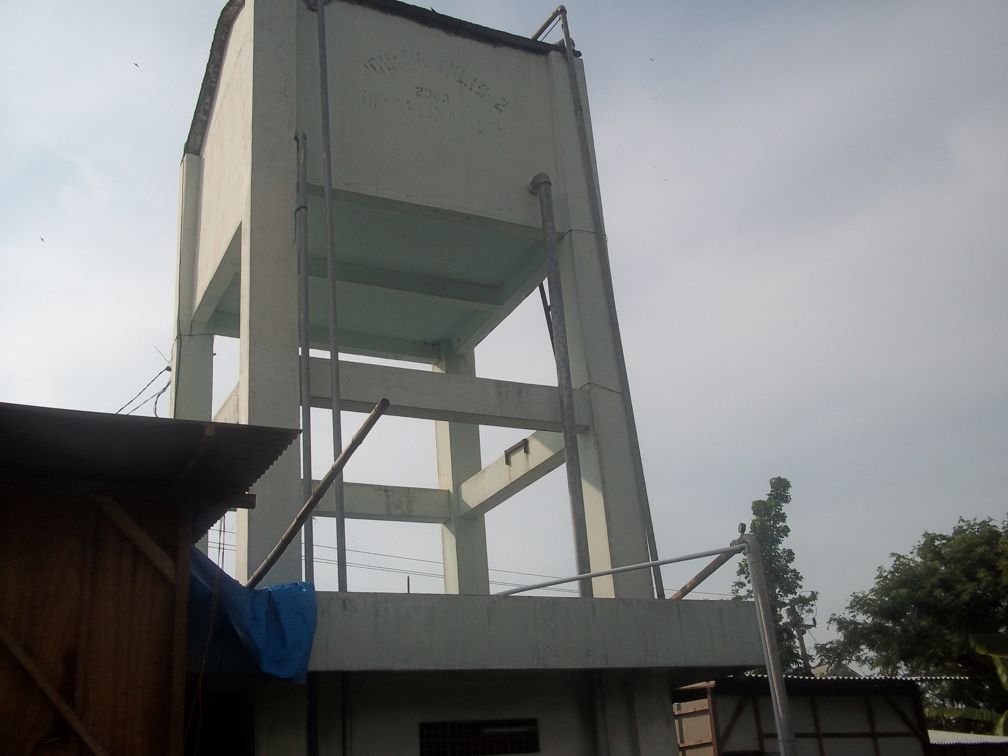
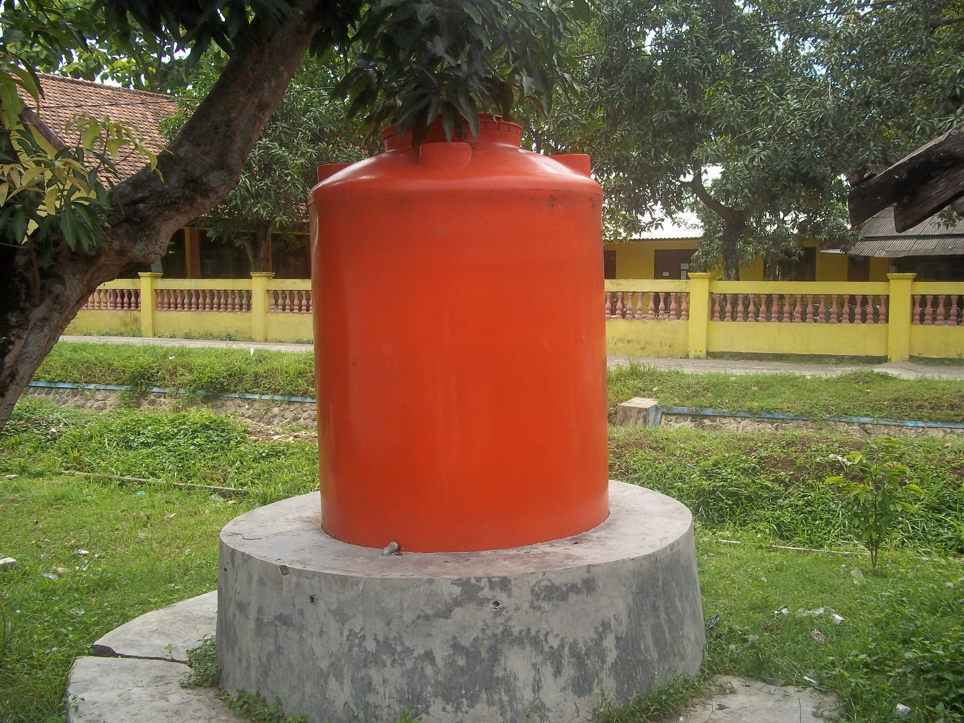
Asset base is developing rapidly, but still no security in terms of land tenure

Slide 24
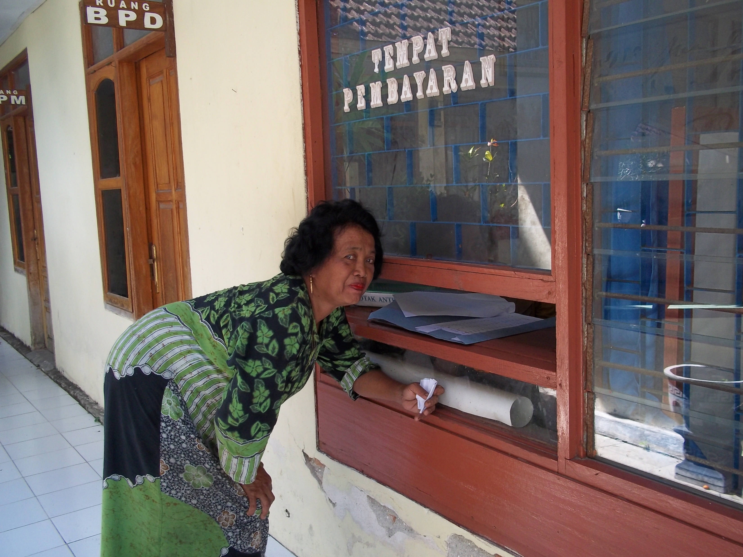
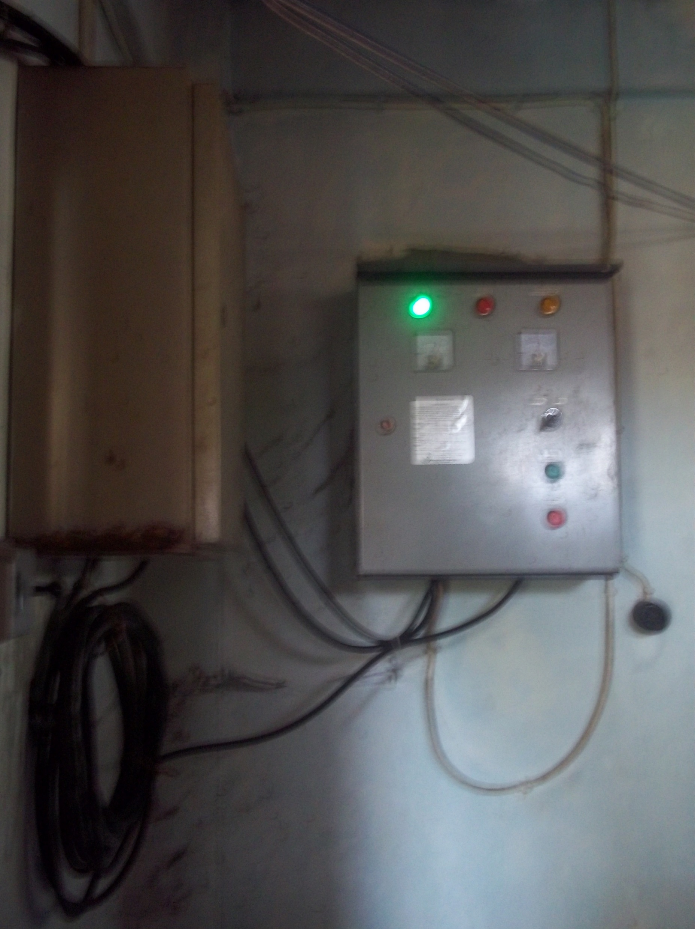
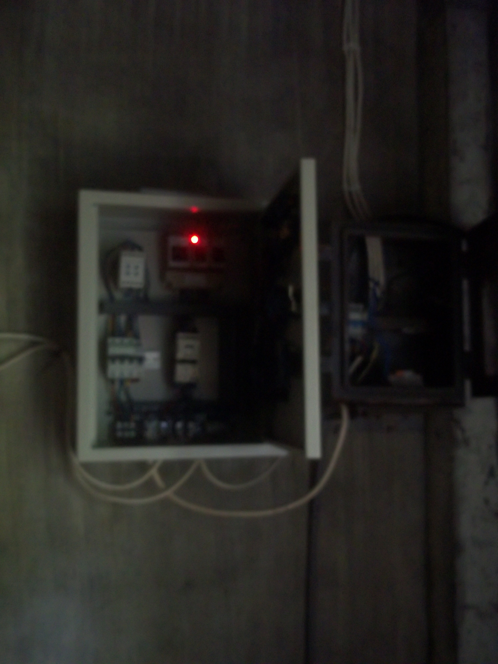
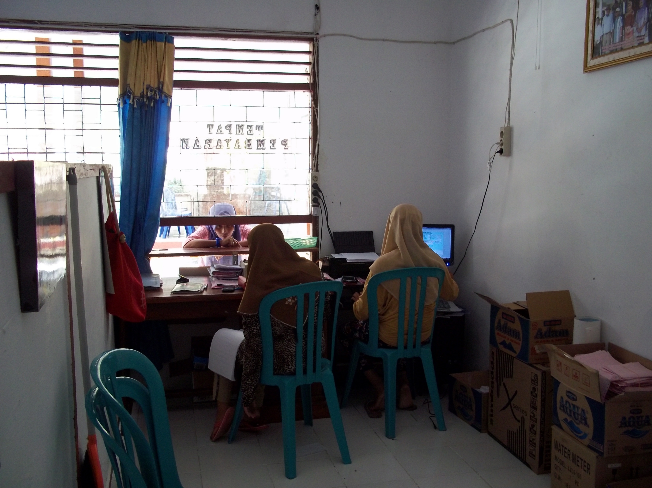
Vicinity to supplies (major cities), know-how (resource person) and reliable/affordable energy supply affects Operation and Maintenance. These resources are not available in Maukaro.
HIPPAMS Tirto Agung used computerized accounting software for billing

Slide 25
Some Reflections on the Two Case Studies
Factors | Similarities
Dominant Figure | Successful CBOs relies on one dominant figure. Thus, regeneration is difficult.
Motivation | Money is not the motivation. Recognition and appreciation appears to be the primary motive.
Technical Person | The role of technical person is vital, but often underappreciated.
Role of women | We have yet to meet a women as CBO Chairman. Women are usually positioned as secretary or treasurer
Elite Formation | When successful, CBO officials becomes the new village elite
Factors | Differences
Access to Resources | It takes 6 hours from Maukaro to Ende but takes only 2 hours from Lamongan to Surabaya. There is more access to know-how and skilled resources in Lamongan.
Role of Adat | Adat elites are dominant political force in NTT (aside from local bureaucracy, religious leaders and CBOs). Each of these forces are in some form of tensions. In Eastern Java the Adat is intermingled with bureaucracy
Local politics | The importance to be independent from local politics is stressed in Eastern Java (and intervention from local politics has disrupted services) but less so in Eastern Nusa Tenggara

Slide 26

Thank You
Download full report and other materials:
https://crpg.info/41-aiira

